Slide 1


Leasing as a Risk-Sharing Mechanism
Kai Li & Chi-yang Tsou
SSRN 2022

Slide 2
How does Leasing Segment Aggregate Firm Risk?
WSU
Research Question
Theoretical
Risk-tolerant lessors
Capital owners effectively provide insurance to financially constrained..
Risk-averse lessees
Capital borrowers against systematic capital price fluctuations
Empirical
Novel Risk Premium Channel
Lease-induced liability and financial debt should not be treated equally
Leased Capital Ratio
Using PPENT, equal to the leased capital with respect to the total capital

Slide 3



The Flow of Risk
WSU
Research Question
“In this paper, we argue that leasing is a risk-sharing mechanism, as risk-tolerant lessors (capital owners) effectively provide insurance to financially constrained, risk-averse lessees (capital borrowers) against systematic capital price fluctuations.”
Payment
Risk
Owner’s Purchase
Borrower’s Lease
Aggregate Risk
“Short Position”

Slide 4
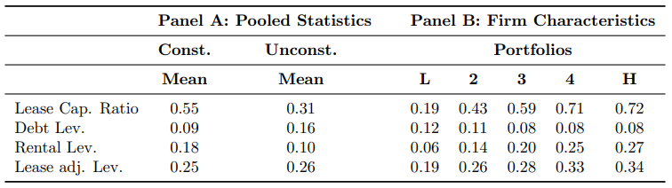
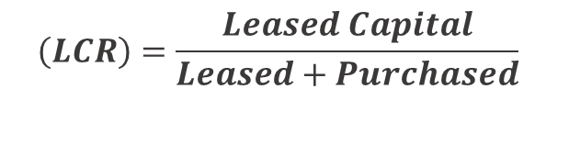
Novel Leased Capital Ratio
WSU
Ratios
Panel A (Whited-Wu Index)
The average LCR for constrained firms is higher than that of unconstrained firms → financially constrained firms lease more
Debt leverage for constrained firms is lower than unconstrained firms → leasing is an essential source of external financing for financially constrained firms
Panel B (Constrained Firms)
Large dispersion in LCR when sorted by LCR into five Compustat quintiles
Debt-leverage is downward sloping
Leasing is an important channel of financing for constrained firms
$$\left(LCR\right)=\frac{Leased Capital}{Leased+Purchased}$$

Slide 5
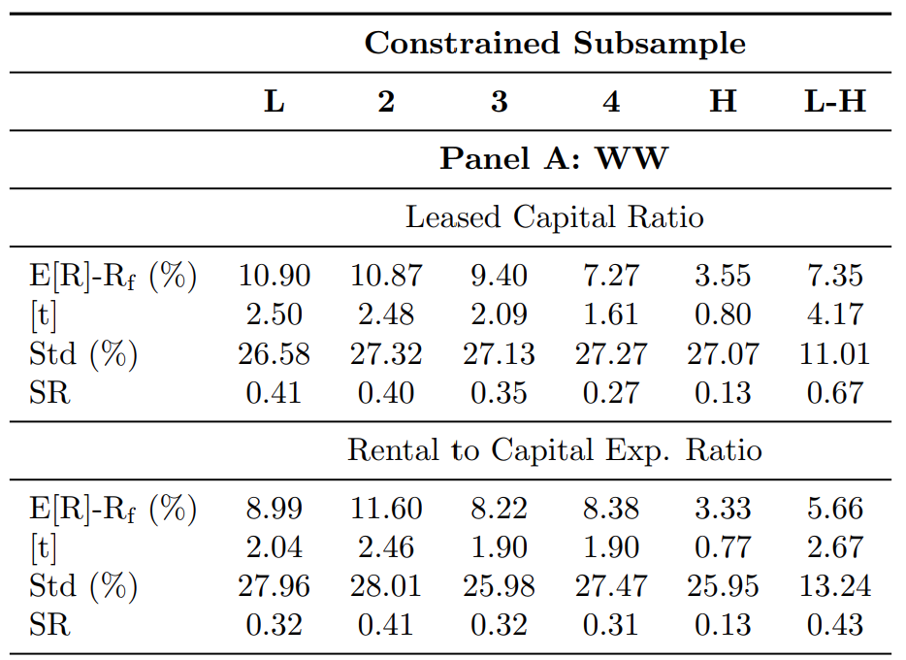
Negative Leased Capital Premium
WSU
Ratios
The relation between leased capital ratios and expected returns
Firms are sorted by LCR in year t – 1
Portfolios’ value-weighted returns are calculated monthly then annualized (t to t + 1)
This long-short portfolio return is economically large (7.35% per annum) and significant at the 1% level
The annualized Sharpe ratio is also economically sizable (about 30% higher than the aggregate stock market index)

Slide 6
General Equilibrium Model
WSU
Model
The nature of collateral constraints and a firm’s dynamic decision to lease or buy:
“Our paper is also related to several papers that study the real effect of the anti-recharacterization laws on corporate policies. Li, Whited, and Wu (2016) and Fairhurst and Nam (2021) investigate the impact of laws on capital structure and corporate precautionary behaviors.”
Authors develop a model in a general equilibrium framework with heterogenous firms, enabling them to model the competitive lessor’s problem and endogenize the leasing fee to depend on fundamental shocks
Authors focus on the asset pricing implications of the leased capital on firms’ asset side
How do anti-recharacterization laws provide exogenous variation to support empirical evidence on the dynamic lease versus buy trade-off?

Slide 7
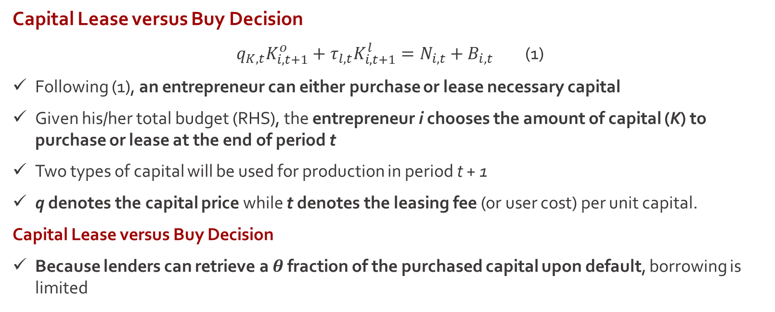
General Equilibrium Model
WSU
Model
Capital Lease versus Buy Decision
$q_{K,t}K_{i, t+1}^{o}+τ_{l,t}K_{i, t+1}^{l}=N_{i,t}+B_{i,t}$ (1)
Following (1), an entrepreneur can either purchase or lease necessary capital
Given his/her total budget (RHS), the entrepreneur i chooses the amount of capital (K) to purchase or lease at the end of period t
Two types of capital will be used for production in period t + 1
q denotes the capital price while t denotes the leasing fee (or user cost) per unit capital.
Capital Lease versus Buy Decision
Because lenders can retrieve a $θ$ fraction of the purchased capital upon default, borrowing is limited

Slide 8
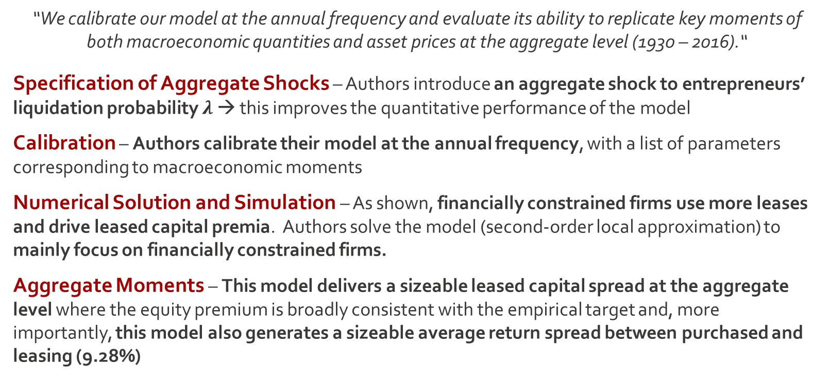
Quantitative Model Predictions
WSU
Model
“We calibrate our model at the annual frequency and evaluate its ability to replicate key moments of both macroeconomic quantities and asset prices at the aggregate level (1930 – 2016).“
Specification of Aggregate Shocks – Authors introduce an aggregate shock to entrepreneurs’ liquidation probability $λ$ → this improves the quantitative performance of the model
Calibration – Authors calibrate their model at the annual frequency, with a list of parameters corresponding to macroeconomic moments
Numerical Solution and Simulation – As shown, financially constrained firms use more leases and drive leased capital premia. Authors solve the model (second-order local approximation) to mainly focus on financially constrained firms.
Aggregate Moments – This model delivers a sizeable leased capital spread at the aggregate level where the equity premium is broadly consistent with the empirical target and, more importantly, this model also generates a sizeable average return spread between purchased and leasing (9.28%)

Slide 9
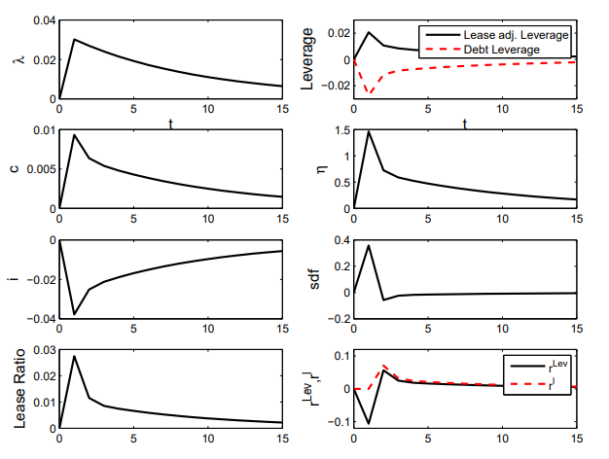
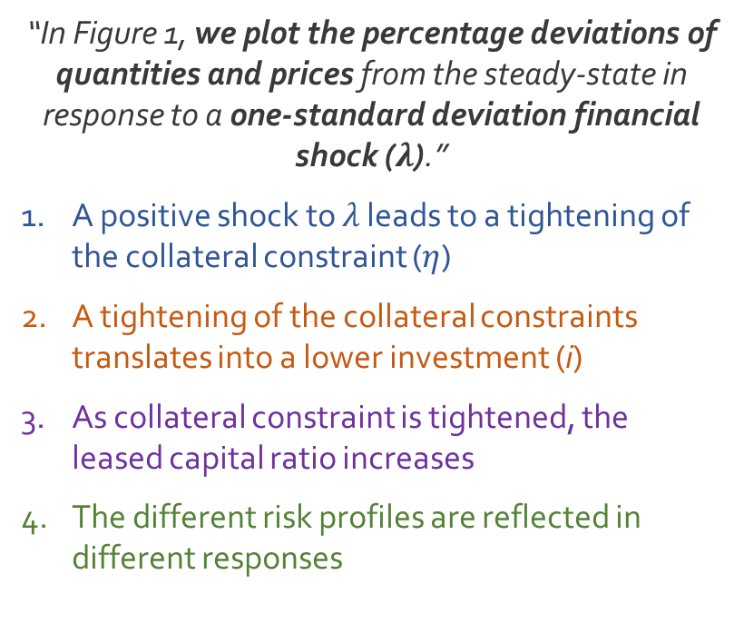
Asset Pricing Implications
WSU
Impulse Response Functions
“In Figure 1, we plot the percentage deviations of quantities and prices from the steady-state in response to a one-standard deviation financial shock ($λ$).”
A positive shock to 𝜆 leads to a tightening of the collateral constraint ($η$)
A tightening of the collateral constraints translates into a lower investment (i)
As collateral constraint is tightened, the leased capital ratio increases
The different risk profiles are reflected in different responses

Slide 10
Empirical Analysis
WSU
Implications
Let’s consider two firms that hold the same lease-adjusted leverage but differ in the choice between the usage of lease and financial debt.
Causal Evidence
The primary challenge is to find exogenous variation in the leased capital ratio to identify the causal effect on lessee firms’ risk exposure
To overcome this, the authors exploit exogenous variation from the passage of anti-recharacterization laws
Consistent with theory: firms in the treated states become more exposed to financial shocks because the passage of anti-recharacterization laws reduces firms’ usage of leases and therefore mitigates the risk-sharing role of leased capital
“Anti-recharacterization laws limit the ability of courts to recharacterize these (SPVs) assets as loans.”
- Fairhurst & Nam (2021)

Slide 11



Conclusions
WSU
Lease-induced liability and financial debt should not be treated equally on firms’ balance sheets, as their implications for firms’ equity risks and cost of equity are opposite.
How might these results change for IP operating leases?
Is the enactment of these laws exogenous?
These laws were in large part lobbied by financial institutions trying to preserve the value of assets in lending
Fairhurst & Nam (2021) exclude utility and financial firms

